Slide 1
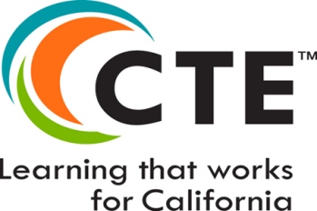
Implementation of College and Career Readiness Standards
Presented by
Carolyn Zachry
Education Administrator
Career and College Transition Division
California Department of Education
Notes:
Welcome audience
Quick survey of who the audience is (Teachers, Site Administrators, Counselors, COE or District Superintendents)
Acknowledge any CDE staff in room and any members of the CCSESA CTE Workgroup

Slide 2
Video: 21st Century Skills: How Do We Get There?

Slide 3
Mainly, the developers of the CCSS asked this question:
What will our high school graduating students need to know and be able to do in order to be successful in college or entering into the work force?

Slide 4
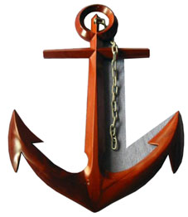
In answer to this question
Thirty-two statements regarding reading, writing, speaking and listening and the proper use of language were crafted.
These statements became the ANCHORS for the English Language Arts standards.

Slide 5
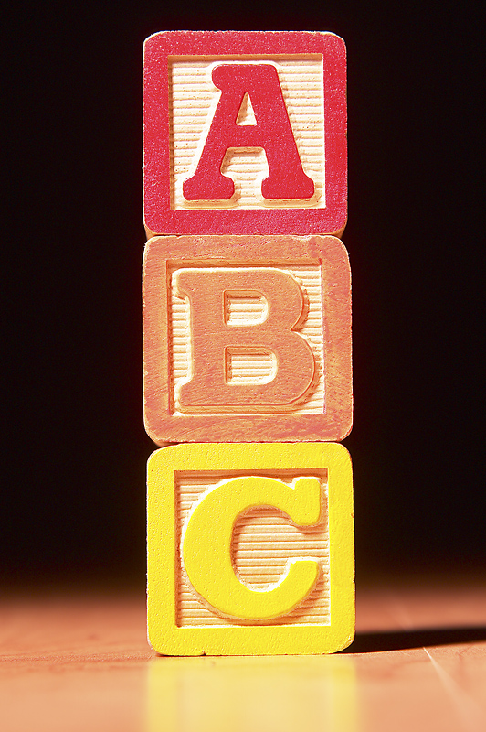
Staircase of Complexity
The standards are designed from College and Career, Life-Long Transfer Goals, called Anchor Standards, and backwards mapped all the way down to kindergarten.

Slide 6
Rigorous CTE Courses Reflect CCSS Learning Expectations
Clearer, fewer, higher aligned to college and career expectations.
Solve challenging and complex problems.
Design student tasks that rigorous and relevant.

Slide 7
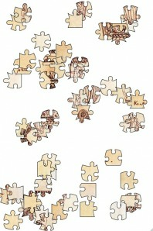
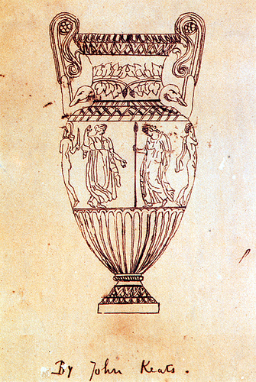
Big Ideas Lead to Deeper Understanding
CA-97
Isolated Skills
CCSS/ CTE
Skills Organized Around Big Ideas
Source: Tools for the Common Core (http://commoncoretools.me/2012/02/16/the-structure-is-the-standards/)

Slide 8
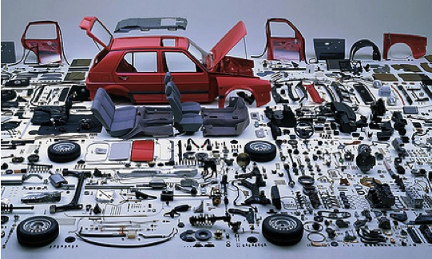
…like trying to understand a car by studying its parts in isolation

Slide 9
College and Career Ready Anchor Standards

Slide 10
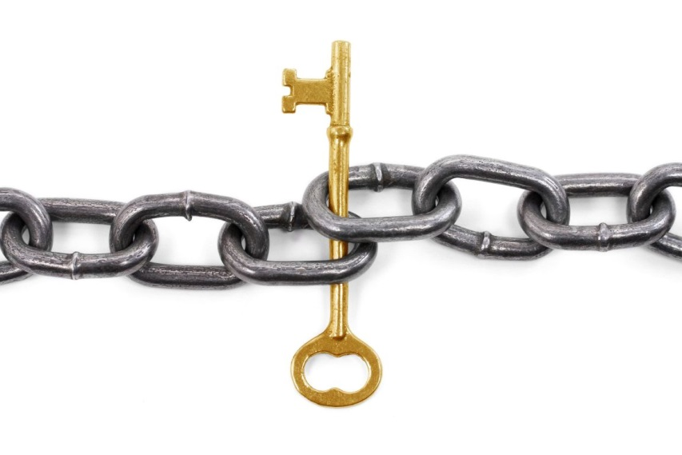
Rigor and Relevance Connects CTE and CCSS
CCSS/ CTE standards focus on
rigorous and relevant curriculum,
application of knowledge and skills, and
interdisciplinary activities.

Slide 11
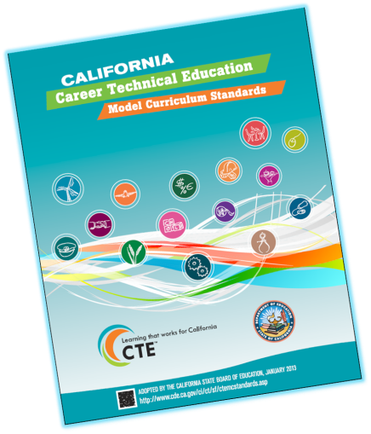
New Standards- What’s Different
Industry & Pathway Updates
Anchor Standards- CCSS Relationship
CCSS Alignment Matrices
Career Ready Practices
Notes:
The Career Technical Education (CTE) Model Curriculum Standards are designed to assist in developing high quality curriculum and instruction to help ensure students are career and college ready. The new Common Core State Standards require academic teachers to include real world applications in their curriculum. Who better to support them than CTE teachers who have always included real world relevance in their curriculum? The result: better prepared students
The standards offer clear guidelines for course content development and expectations for student achievement.
Standards are rigorous, research-based, evidence-based, relevant, and reasonable in scope.
Building on their format, the revised CTE Model Curriculum Standards expands the research base used in writing the standards. The additional research includes the Wisconsin Center of Educational Research Depth of Knowledge Levels, the Rigor/Relevance Framework from the International Center for Leadership in Education, and A Model of Learning Objectives based on A Taxonomy for Learning, Teaching and Assessing: A Revision of Bloom’s Taxonomy of Educational Objectives from the Iowa State University Center for Excellence in Learning and Teaching.

Slide 12
Standards Continuum: Standards for Career Ready Practice
Pathway Standards
Industry Sector Anchors
(Knowledge and Performance Anchor Standards)
✔ Standards for Career Ready Practice
Industry Specific
Employer
Notes:
Ask for audience participation…. Ask them why…

Slide 13
Standards for Career Ready Practice
Adapted from the National Career Technical Common Core
Align with Skills for the 21st Century
Describe the fundamental knowledge and skills needed to be ready for careers AND college
Adapted from the National Common Career Technical Core
Not exclusive to a career pathway, CTE program of study, a particular discipline, or grade level
Notes:
The Standards for Career Ready Practice are adapted from the National Common Career Technical Core; over 42 states were involved in the development of these practices. The twelve Standards for Career Ready Practice reflect the expectations from business and industry, labor, community, and education representatives from over 40 participating states and align with the CTE anchor standards.
These new Standards for Career Ready Practice were adopted for California and based on the “Career Ready Practices” adopted by the Common Career Technical (CCTC). The CCTC practices are posted at: http://www.careertech.org/
These were derived from the Secretary’s Commission on Achieving Necessary Skills (SCANS) Report first published in the 1990’s.

Slide 14
Standards for Career Ready Practice
Increase in complexity and expectation as student advance through a program of study
Are taught and reinforced in all career exploration or career preparation programs, or integrated into core curriculum
For ALL students, not just CTE students
Notes:
The Standards for Career Ready Practice can be integrated with a course or incorporated into several courses over multiple school years (grades seven through twelve). The practices are expectations for all students, whether they are enrolled in a CTE program or following a more generalized course sequence. It is expected that all students who exit high school will be proficient in these practices.

Slide 15
Standards for Career Ready Practice
Career Ready Practices describe the fundamental career ready knowledge and skills a career ready student needs to prepare for transition to postsecondary education, career training, or the workforce. These practices are not exclusive to a career pathway, a Career Technical Education (CTE) program of study, a particular discipline, or level of education. Career Ready Practices are taught and reinforced in all career exploration and preparation programs with increasingly higher levels of complexity and expectation as a student advances through a program of study. Career Ready practices are a valuable resource to CTE and academic teachers designing curricula and …
Notes:
Standards for Career Ready Practice (much of this is addressed in the Common Core which was taken from the College and Career Readiness standards)
The twelve Career Ready Practices reflect the expectations from business and industry, labor, community, and education representatives from over 40 participating states and align with the CTE anchor standards.
“Career Ready Practices describe the career-ready skills that educators should seek to develop in their students. These practices are not exclusive to a Career Pathway, program of study, discipline or level of education. Career Ready Practices can be taught and reinforced in all career exploration and preparation programs with increasingly higher levels of complexity and expectation as a student advances through a program of study.” (NASDCTEc Common Career Technical Core, 2012)
The career ready practices can be integrated in a course or incorporated into several courses over multiple school years. The practices are expectations for all students whether enrolled in a CTE program or a more generalized academic course sequence. It is expected that all students upon exiting high school will be proficient in these practices.
CDE is working to integrate these Standards for Career Ready Practice into all CCSS documents in California. These are to be shared with academic teachers as well as CTE teachers.

Slide 16
Standards for Career Ready Practice
Apply appropriate technical skills and academic knowledge
Communicate clearly, effectively, and with reason
Develop an education and career plan aligned to personal goals
Apply technology to enhance productivity
Utilize critical thinking to make sense of problems and persevere in solving them
Practice personal health and understand financial literacy
Notes:
Standards for Career Ready Practice: reference pages 11 & 12 of the CTE Model Curriculum Standards Executive Summary.
Cue audience to pull out/ or pass out Handout module 1-#4: Standards for Career Ready Practice
These are for ALL students, not just CTE students!
This is the foundation that all students need to be ready for careers AND college. We will take a closer look at these in Module 2.

Slide 17
Standards for Career Ready Practice (continued)
Act as a responsible citizen in the workplace and the community
Model integrity, ethical leadership, and effective management
Work productively in teams while using cultural/global competence
Demonstrate creativity and innovation
Employ valid and reliable research strategies
Understand the environmental, social, and economic impacts of decisions
Notes:
They are adapted from the National Common Career Technical Core and funded by the National Association of State Directors of CTE Consortium; over 42 states were involved in the development of these practices. This was a national effort to make certain ALL students get this information. These are the updated version of the 21st SCANS skills. Discuss these standards in depth.

Slide 18
Standards for Career Ready Practice
Notes:
The Standards for Career Ready Practice are adapted from the National Common Career Technical Core; over 42 states were involved in the development of these practices. The twelve Standards for Career Ready Practice reflect the expectations from business and industry, labor, community, and education representatives from over 40 participating states and align with the CTE anchor standards.
They can be integrated with a course or incorporated into several courses over multiple school years (grades seven through twelve). The practices are expectations for all students, whether they are enrolled in a CTE program or following a more generalized course sequence. It is expected that all students who exit high school will be proficient in these practices.
These new Standards for Career Ready Practice were adopted for California and based on the “Career Ready Practices” adopted by the Common Career Technical Core (CCTC). The CCTC practices are posted at: http://www.careertech.org/
These were derived from the Secretary’s Commission on Achieving Necessary Skills (SCANS) Report first published in the 1990’s.

Slide 19
Standards for Career Ready Practice Example
3. Develop an education and career plan
aligned to personal goals.
Career-ready individuals take personal ownership of their own educational and career goals and manage their individual plan to attain these goals. They recognize the value of each step in the educational and experiential process, and that nearly all career paths require ongoing education and experience to adapt to practices, procedures, and expectations of an ever changing work environment. They seek counselors, mentors, and other experts to assist in the planning and execution of education and career plans.
Notes:
See Links: California Career Technical Education Model Curriculum Standards (2013)
AKA Personalized Learning Plans, Individual Learning Plans, or Student Learning Plans

Slide 20
Personalized Learning and Individual Learning Plans/Student Learning Plans
When Implemented Well…….
Addresses Career, Postsecondary, and Life Goals
Informed by Career and Self Exploration prior to High School
Motivates all students to “own their own learning”
Can increase engagement of students, teachers, support personnel, parents, and community when implemented well
Positive impact on school climate
Improve academic performance, attendance, graduation rates
Optional modes of delivery: extra-curricular, class-based, “advisory”/school counselor
Notes:
See Resource Sheet
National Collaboration on Workforce and Disability has background
Also George Washington University’s Freshman Transition Initiative

Slide 21
Notes:
Many existing relevant resources not well understood outside of those already with strong CTE/Pathways
Starting place is to have a “map” of where and how career development relates to education.

Slide 22
California Career Resource Network (CalCRN)
CalCRN provides career development resources to promote improved career and education decision-making.
CalCRN’s free career exploration and planning resources are tailored to California’s middle and high school students, but available to all Californians.

Slide 23
CalCRN Resources Linking Information & Imagination
CaliforniaCareers.info
California CareerZone
Career Surfer mobile application
California Career Center

Slide 24
www.californiacareers.info

Slide 25
www.CaliforniaCareers.info
CalCRN Home Page
Links to all CalCRN resources
State Agency Partner links
Presentations inc Power Point and Reports
What’s New inc Meeting Schedule

Slide 26
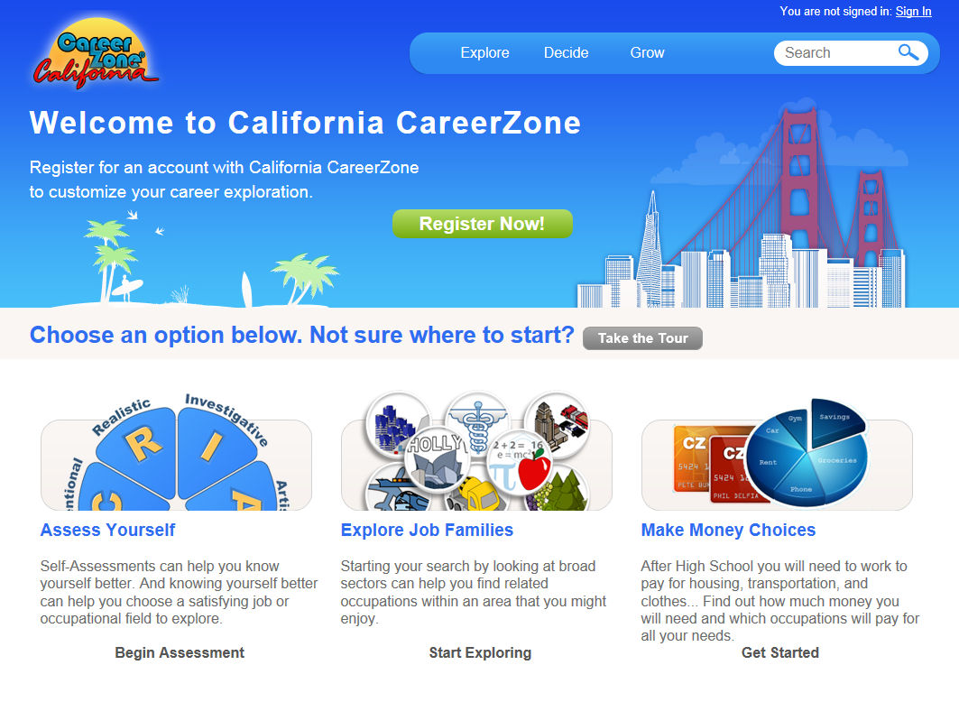
www.cacareerzone.org

Slide 27
California CareerZone
Assess Yourself:
Quick Assessment (Holland)
*Interest Profiler (Holland)
Work Importance Profiler
Skills Profiler
Explore Job Families
23 O*Net Job Families
Make Money Choices
Build a goal lifestyle budget
900 Occupations (300 with videos) (O*Net)
7418 Postsecondary Schools (NCES)
Free Students Accounts
Free Educator Class Management
Notes:
The RIASEC model says that there are six types of people and six corresponding environments.
People are attracted to environments that correspond with their interests.
The Six Basic Ideas of Holland’s Theory:
1. Most people can be classified as one of six personality types: Realistic (R),
Investigative (I), Artistic (A), Social (S), Enterprising (E), and Conventional (C).
2. People of the same personality working together create an environment that fits their type. For example, Social types create a Social environment;
3. There are six basic types of environments: Realistic (R), Investigative (I), Artistic (A), Social (S), Enterprising (E), and Conventional (C);
4. People search for environments where they can use their skills and abilities and
express their values and attitudes;
5. People who choose to study and work in an environment similar to their personality
type are more likely to be successful and satisfied; and
6. How you act and feel depends to a large extent on your school or work environment.

Slide 28
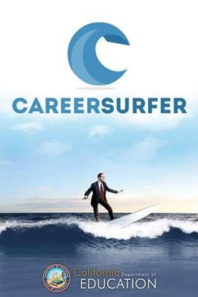
Career Surfer Mobile Application

Slide 29
Career Surfer Mobile Application iTunes and Google Play
900 O*Net Occupations
Title
Description
Tasks
Salary
Education/Training Required
Search by:
O*Net Job Family
Salary
Education Level
Key Word
Shake Phone for Random

Slide 30
Review the Standards for Career Ready Practice.
✓ 1. What you are already doing.
2. What you could integrate?
! 3. What surprises you?
? 4. What standards might you need help with?
Notes:
PRESENTERS CAN DO THIS ACTIVITY IF THEY HAVE TIME
Presenter ask someone to read the first paragraph of page 11 in the Introduction which explains the SCRP.
This can be in booklet form, or printed from www.cde.ca.gov/ci/ct/sf/ctemcstandards.asp
Presenter, then says:
“Put a check mark next to each standard you are already doing in your course.” Allow time to complete this.
“Circle the number next to the standard that you COULD integrate” (example circle #2) Allow time to complete this.
“Place an exclamation mark next to those that surprise you, for whatever reason.” Allow time to complete this.
“Write a question mark next to those you might have questions about or need help with to integrate into your curriculum” Allow time to complete this.
It is helpful if you have teachers sitting together by Industry sector and/or pathway to discuss what they see and share ideas.

Slide 31
Think, Pair, Share
Standards for Career Ready Practice How can all teachers integrate the Standards for Career Ready Practice in their core subjects? 30 seconds
Notes:
Modeling best practices: Think, Pair Share
Mention that this strategy can prepare kids for a reading assignment, or research.
Think: Pose the question and allow participants to think to themselves, or write a response to the prompt.
Pair: Choose a person next to you. This can be done with “numbered heads”, Person A/B, Left/Right, or any way the presenter wants to partner people.
Share: Decide who will go first/second and share your thoughts (presenter may choose to have person A share first, etc.)
This process is helpful to engage teachers in sharing ideas and discussing the fact that ALL teachers should be addressing these Standards for Career Ready Practices, not just CTE teachers.

Slide 32
Student Outcomes
100 Students Start 9th grade:
51 are on a “college prep” track
75 graduate from high school
51 enter college
38 need remediation
26 graduate college
College Completion Toolkit
U. S. Department of Education, March 2011
Notes:
Let’s instead look at outcomes in terms of what happens to students related to their educational experience.
Two years ago the US Dept. of Ed rolled up national outcome data and it looked like this for 100 students starting the 9th grade.
The 50 % - 75% - 50% 25% split has remained remarkably consistent over the last 40 years. Recent gains in grad rates and disadvantaged students aspiring to college have been dampened by the falling career and employment prospects of all educational cohorts, and twin hardships of rising college costs and soaring debt levels.
We have a long way to go to meet our twin goals of college (or other postsecondary) and career for all.
Some have proposed a more accurate “framing” of what are schools are or need to be and that we would be much better able to improve outcomes if we saw schools as resting on a three legged stool
Resources, Organization, Management
Instruction, Curriculum, Assessments
Student Learning Experience (attitudes and beliefs, barriers and supports, identification with learning experience, school climate, etc.)
Recent CA history – budget cuts, “flexed” programs
Student - Counselors 1,016 to 1 (last)
Record youth un and underemployment, falling wages, overeducated job seekers for the jobs that are being created, etc.

Slide 33
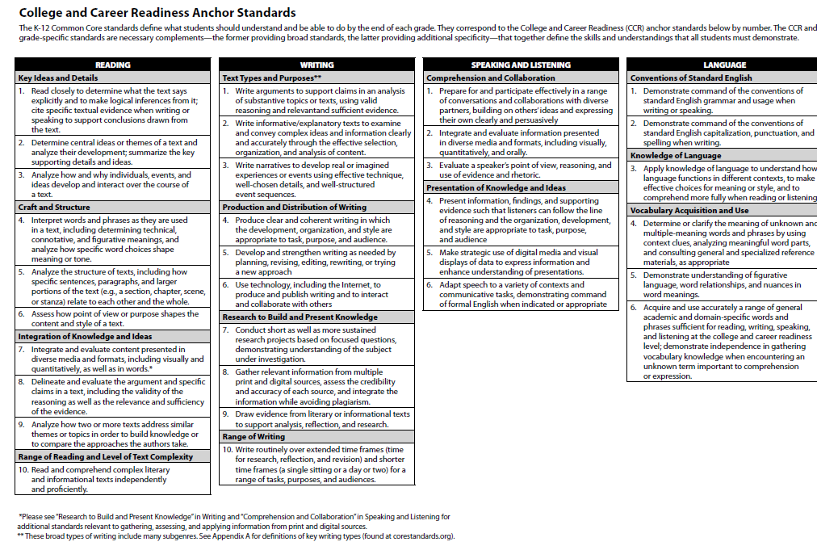
3
2

Slide 34
Defining Career Readiness
California has not, to date, adopted a statewide definition of “career readiness.”
In Building Blocks for Change: What it Means to be Career Ready (2012), the Career Readiness Partner Council, a national coalition of leaders from national education and workforce organizations, defined a “career-ready person” as one who “effectively navigates pathways that connect education and employment to achieve a fulfilling, financially-secure, and successful career.”

Slide 35
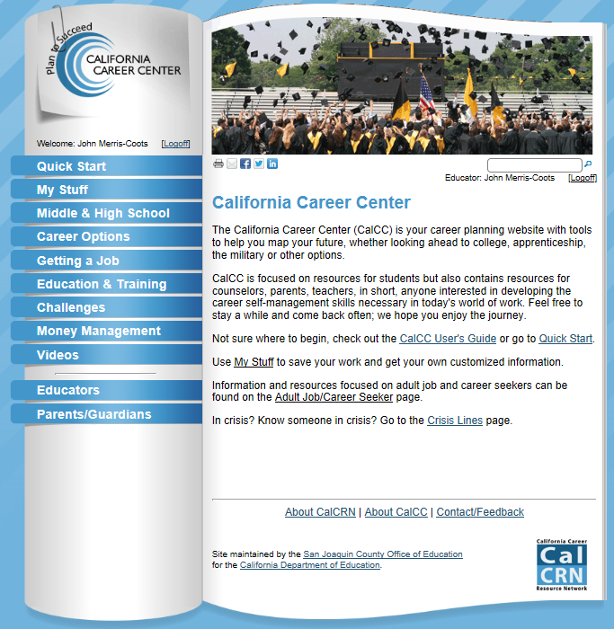
www.calcareercenter.org

Slide 36
California Career Center
Student Content
Quick Start
My Stuff
Middle & High School
Career Options
Education & Training
Getting A Job
Challenges
Money Management
Videos
Also
Crisis Lines
CalCC Users Guide
Adult Job/Career Seeker
Educator Resources
Classroom Ready Curriculum
Lesson Plan Creator
Parent/Guardian Resources

Slide 37
California Career Center Educator Resources
Career Development Parent Handbook in Six Languages
Classroom-Ready Curriculum
Educator Resources
Educator to Educator Resource Sharing
Helping Students Address Challenges
ListServ Sign Up
Student Activities
Support Personnel Accountability Report Card

Slide 38
California Career Center Parent/Guardian Resources
Career Development Parent Handbook in Six Languages
California CareerZone Workbook [PDF]
Helping Your Child Address Challenges
Quick Guide to Career & College Exploration
Web Links: Parents and Guardians

Slide 39
Student Workbook PDFs
Find and Get the Right Job
Step 1: Assess Yourself
Step 2: Prepare for the Job Search
Step 3: Search for a Job
Step 4: Contact Employers
Step 5: Interviewing
Succeed at Work
Step 1: Acting Self-Employed
Step 2: Starting a New Job
Step 3: Being an Excellent Employee
Step 4: Living a Balanced Life
Step 5: Enjoy Your Current Position
Notes:
Career Voyages – U.S. Departments of Education and Labor
www.careervoyages.gov/
College Navigator - U.S. Department of Education
http://collegenavigator.ed.gov
ASVAB – Career Exploration Program – Department of Defense
www.officialasvab.com

Slide 40
CalCRN Email List www.calcareercenter.org/Home/Content?contentID=308
Quarterly meeting announcements, agendas, handouts, follow-up notes
New CalCRN Resources
CalCRN Resource Updates
Career guidance resources/training

Slide 41
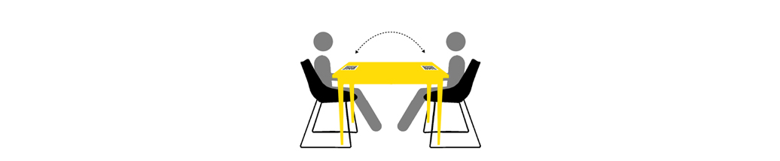
Table Talk
Consider what you have just seen.
In light of this information, what thoughts might you have regarding your position and the role that you play in preparing students to be become college and career ready.
Take a moment to jot thoughts on a post-it note.
When everyone is ready, share your thoughts with the table group.

Slide 42
Activity: Collaborative Learning (Instructional Strategy)
Directions:
In like subject area groups, review your pathway standards (10-15 minutes)
Identify your ah-ha’s
Discuss at least 2 strategies for integrating standards into your course/instruction
Report out
Notes:
Note that this is a quick “reflection strategy”

Slide 43
“Success seems to be connected with action. Successful people keep moving. They make mistakes, but they don't quit.”
Conrad Hilton, Hilton Hotels

Slide 44
THANK YOU
Career and College Transition Division
Career Technical Education Administration and Management Office
Carolyn Zachry,
Education Administrator
916-323-5042
czachry@cde.ca.gov
Additional Information
California Career Resource Network Contact Information
John Merris-Coots
916-324-8151 jmerris@cde.ca.gov

